Slide 1
PROJECT TITLE
“e – Copy Evaluation System”

Slide 2
PREPARED BY
PRATAP KUMAR SEN
Univ. Roll No. – 11MCA046
Session - 2011 - 14
Reg. No. – PG00007/2011
Ranchi University,
Ranchi.

Slide 3
The Route Map
Introduction
Objective
Advantage
Tools used
Programming language used
Technique used
Working technique
System requreiment specification
Design
  DFD
  ER Diagram
  Flow chart
Table structure
Screen Shorts
Test Cases
Limitation
Future application of project
Bibliography

Slide 4
Introduction
Now a days the almost everything is based on online (for example- Net banking, paying bills, online shopping etc.) that save the time and reduce the cost. So today almost all the fields make use of computers and database as key factors to store data and to keep track of records for easier retrieval of data and maintenance. “e -Copy Evaluation System” is a web based application system, which simplify the copy correction by the evaluators, make it online. There is no paper work, less time to generate the result. In this system Evaluator can see the answer sheets online, they can Evaluate the copy by giving mark to each answer. This checked copies are save by evaluator into the server and marks are directly stored in Database (instead of manual tabulation) to making result, that will minimize the scope of errors and ensure an error-free evaluation system.
The whole process of evaluating and generating the result was done manually till date. It is very time consuming and it is difficult to keep the answer sheets, as well the maintenance of the of the record of each examinee. The chance of loss of records is high and record searching is difficult. Result processing takes more time and the presence of more invigilators is a must if there are more number of students to write the exam.

Slide 5
Introduction continue…
e – Copy Evaluation System is truly transparent system, the checked answer sheets marks are automatically added, so there is no chance of wrong totaling. At the same time that checked answer sheet marks are automatically upload to the server by evaluator when he finished the evaluation of answer sheet. So there is no need of tabulation, which save the time as well cost. The checked answer sheet will also uploaded on server by evaluator, when the result declared the student will see his marks as well as the checked answer sheet on internet. So there is no need of re-totaling of answer sheet. Which makes the transparent to all because all information are stored on server. If we look at the today’s existing system all these works are done manually which is time consuming process.
The main reason to develop this system to save the time, to make evaluation process computerized, and most important thing is that it is transparent to all. The storage of records are electronic and the searching of data and maintenance of records are easy in compare to existing system.

Slide 6
Objective
The main objective of the proposed system is that helps Educational Organization / institutions to simplify the copy Evaluation within less time.
The Evaluation process truly transparent for all.
To make fastest way of evaluation of answer sheets.
To make evaluation process computerized.
To minimize the manual work load.
To finished paper work.
To generate error free result for the students.
To minimize the queries of the student about his/her answer sheet and result.

Slide 7
Advantage
The Evaluation process of this system is computerized. Which make it fastest way to evaluate answer sheet.
This system is computerized, i.e. everything is done program so there is no need of large man power for this process.
There is no paper work in this system.
The chance of loose of records is less.
The record searching is easy and fast.
The storage of answer sheets are electronically.
It is transparent to all.
There is no need of re-totaling of answer sheet because totaling is done automatically.
The student can see their corresponding result as well as the checked answer sheet copies.

Slide 8
Tools Used
FRONT END TOOLS :
HTML5
CSS
JavaScript
JQUERY
DREAMWEAVER
ADOBE PHOTOSHOP
DATA BASE : MYSQL
SERVER : WAMP SERVER
LANGUAGE : PHP

Slide 9
HTML5: (Hyper Text Markup Language): It is used to create static web pages. HTML provides tags (special codes) to make the document look attractive. HTML tags are not case-sensitive. Using graphics, fonts, different sizes, color, etc., can enhance the presentation of the document. Anything that is not a tag is part of the document itself.
Css: (Case cading style sheet): CSS is designed primarily to enable the separation of document content (written in HTML or a similar markup language) from document presentation, including elements such as the layout, colors, and fonts.

Slide 10
JavaScript: (sometimes abbreviated JS) is a prototype-based scripting language that is dynamic, weakly typed and has first-class functions. It is a multi-paradigm language, supporting object-oriented, imperative, and functional programming styles.
JQuery: Jquery is used for to make drawing pad for canvas area, where the evaluator can give the appropriate marks on scanned answers sheet.
Adobe Dreamweaver: it is a web design and development application that provides a visual WYSIWYG editor (colloquially referred to as the Design view) and a code editor with standard features such as syntax highlighting, code completion, and code collapsing as well as more sophisticated features such as real-time syntax checking and code introspection for generating code hints to assist the user in writing code. The Design view facilitates rapid layout design and code generation as it allows users to quickly create and manipulate the layout of HTML elements.
Adobe Photoshop: It is used to editing the image, decorating the image.

Slide 11
DATABASE
MYSQL: It is used for to store data, information and locations of the images which is saved on server. To use of MYSQL queries, we get the information what we want. With the help of mysql we create tables, and we inset, delete and update the data. All informations are store in database, and the mysql helps the to do operations on that information.
SERVER
Wamp Server 2.0: Wamp Server is an open source software implementation of the PHP Server Pages technologies.

Slide 12
Programming language used
PHP: PHP stands for PHP: Hypertext Preprocessor .
-PHP is a server-side scripting language, like ASP .
-PHP supports many databases (MySQL, Informix, Oracle etc)
-PHP is an open source software.
-PHP is free to download and use.
-This is one of the technologies created to enable development of platform- independent web-based applications.
- It uses php, a language that already has a large skill set of developers and a massive amount of functionality available.
-PHP is also conducive to scalability as it distributes across multiple computers well.
-Technology that facilitates the development of dynamic Web pages and Web applications that use existing components, such as Web Objects components.

Slide 13
-PHPs are executed faster.
-PHP is More Secure.
-PHP is compatible with almost all servers used today (Apache, IIS, etc.).
-PHP is FREE to download from the official PHP resource: www.php.net.
-If your server supports PHP - you don't need to do anything! You do not need to compile anything or install any extra tools - just create some .php files in your web directory - and the server will parse them for you. Most web hosts offer PHP support.
-PHP runs on different platforms (Windows, Linux, Unix, etc.)

Slide 14
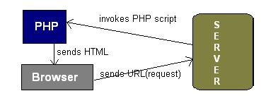
Three Tire Architecture
Working technique of PHP
PHP sits between your browser and the web server. When we type in the URL of a PHP website in your browser, your browser sends out a request to the web server. The web server then calls the PHP script on that page. The PHP module executes the script, which then sends out the result in the form of HTML back to your browser, which you see on the screen. Here is a basic
php diagram which illustrate the process.
Fig: Php Process Diagram.

Slide 15

The working Technique
e- Copy evaluation system
Request for registration
Request for registration
SCHOOL 1
SCHOOL 2

Slide 16
The working Technique
e- Copy evaluation system
School Registered
code =101
School Registered
code=102
SCHOOL 1
SCHOOL 2

Slide 17
The working Technique
e- Copy evaluation system
School now insert the student details with internal marks
SCHOOL login via school name, registered code and password

Slide 18

The working Technique
e- Copy evaluation system
Request for registration
Request for registration
SCANNER (Science)
SCANNER (Math)

Slide 19
The working Technique
e- Copy evaluation system
Scanner Registered
code =15
Scanner Registered
code=10
SCANNER (Science)
SCANNER (Math)

Slide 20

The working Technique
Scanned answer sheet
SCANNER (Science) has the hard copy of answer sheet( science ) of a roll no. with corresponding school registered code and scanner scan the hard copy and store in .jpeg or.png format and put unique code of each image
Hard copy
e- Copy evaluation system
SCANNER (Science) login via name, subject name, registered code and password and upload the scanned answer sheets with corresponding school name, school registered code and roll no.
Scanned answer sheet

Slide 21

The working Technique
e- Copy evaluation system
Request for registration
Request for registration
Evaluator (Science)
Evaluator (Math)

Slide 22
The working Technique
e- Copy evaluation system
Evaluator Registered
code =7
Evaluator Registered
code=9
SCANNER (Science)
SCANNER (Math)

Slide 23

e- Copy evaluation system
Scanned answer sheet
Allot the copies to the Evaluators with corresponding subject
Evaluator open the allotted copies & evaluate the copies and insert the marks of each answer.
e- Copy evaluation system
Evaluator upload the marks and the checked answer sheet

Slide 24

The working Technique
e- Copy evaluation system
Request to view the result and evaluated answer sheet
Allow to view the corresponding result and evaluated answer sheet

Slide 25
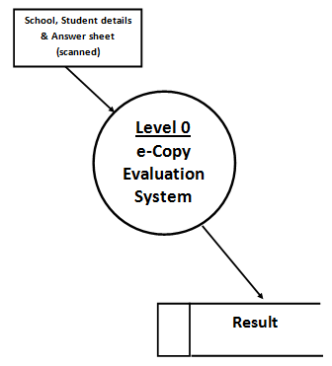
DFD
Contest level DFD

Slide 26
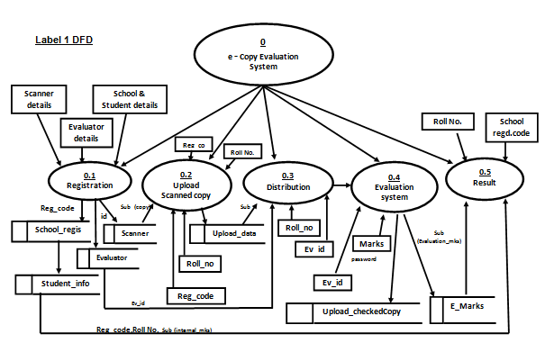
Level 1 DFD

Slide 27
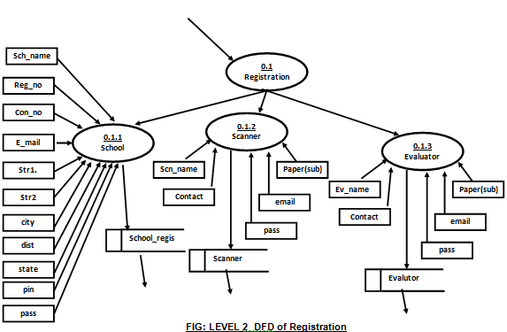
level 2 DFD

Slide 28
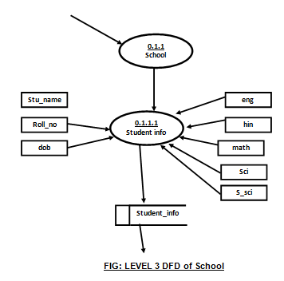
level 3 DFD

Slide 29
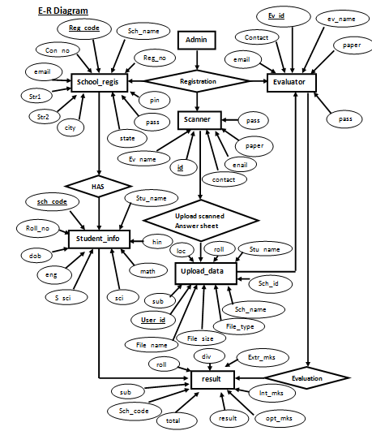
E-R diagram

Slide 30
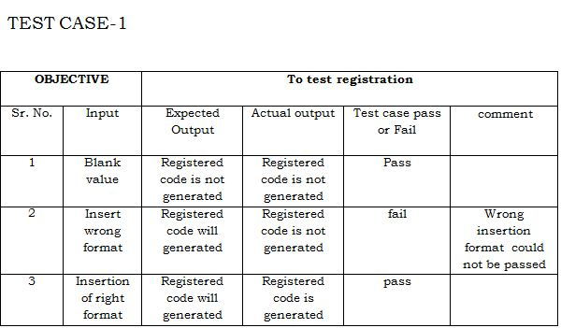
Test Cases

Slide 31
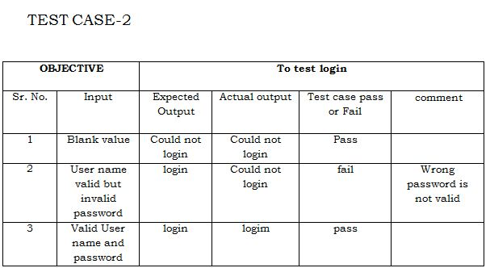

Slide 32
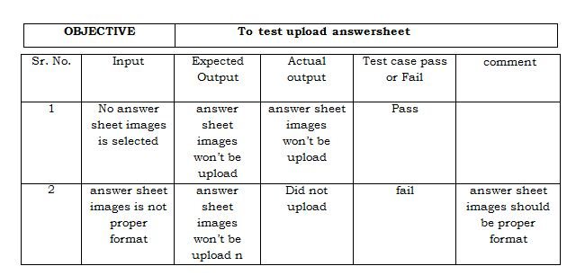
Test case III

Slide 33
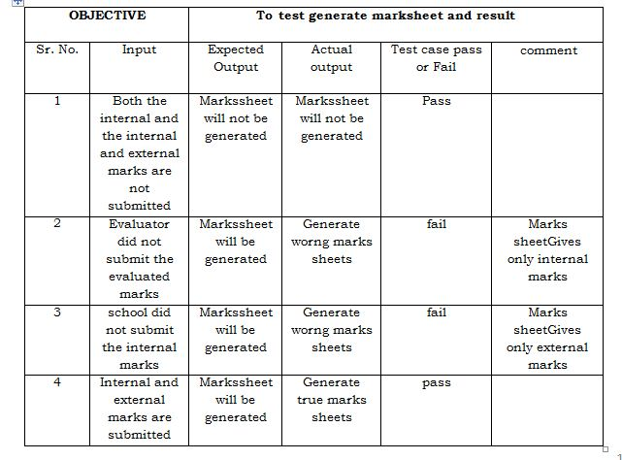
Test case IV

Slide 34
Limitation
It is online evaluation process so the Evaluator should be knowledge about the internet and computer.
.
If the server is not working the System will not be use
Time is taken by scanner to scan and the upload the copy

Slide 35
Feature Scope
Any company can implement this project, many companies takes the exam of their employee for their promotion, after evaluation employee can see the their checked copies.

Slide 36
Bibliography
1 www.shineskills.com
www.Google.co.in
www.wikipedia.com
www.eci.com
www.w3school.com
Database System Concepts :-H.F.KORTH, McGraw HILL Publications
SQL, PL/SQL The Programming Language of ORACLE:-IAVN BAYROSS, BPB Publications
Php, MySQL, Javascript & CSS – Robin Nixon
Dreamweaver CSS, Web Development – David Karlins
.

Slide 37
Thank You

